Slide 1


PERFORMANCE EVALUATION OF IoT PLATFORMS IN GREEN ICT APPLICATIONS
UNB
By: Nasrin Eshraghi Ivari

Slide 2



Selected Thesis
Danial A.Qureshi, PERFORMANCE EVALUATION OF IoT PLATFORMS IN GREEN ICT APPLICATIONS, 2018, Lappeenranta University of Technology, Finland. School of Engineering Science. Erasmus Mundus Master’s Program
But why this thesis?
    This research evaluate the different IoT platforms
    My research is related to IoT and sensors
    Recently published
    Easy to read thesis
Notes:
It evaluate the different IoT platforms
My research is related to IoT and sensors
Recently published
Easy to read thesis

Slide 3
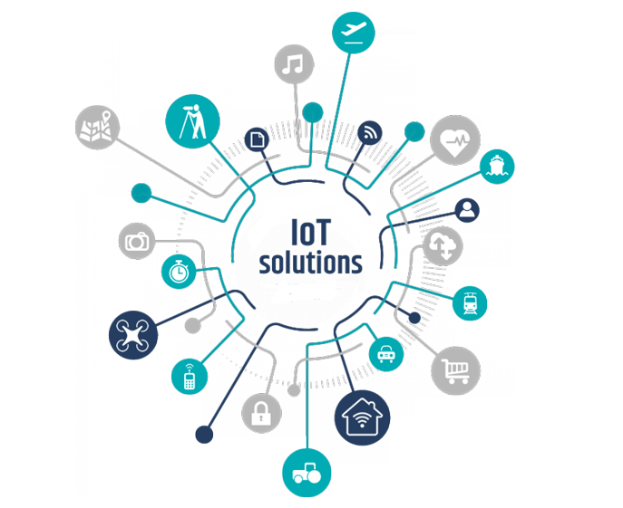
Introduction
Internet of Thing (IoT)
  IoT is a system of interrelated computing devices, mechanical and digital machines, objects, animals or people that are provided with unique identifiers and the ability to transfer data over a network without requiring human-to-human or human-to-computer interaction
    Real-time analytics
    Machine learning
    Commodity sensors
    Embedded systems
Notes:
The definition of the Internet of Things has evolved due to the convergence of multiple technologies

Slide 4
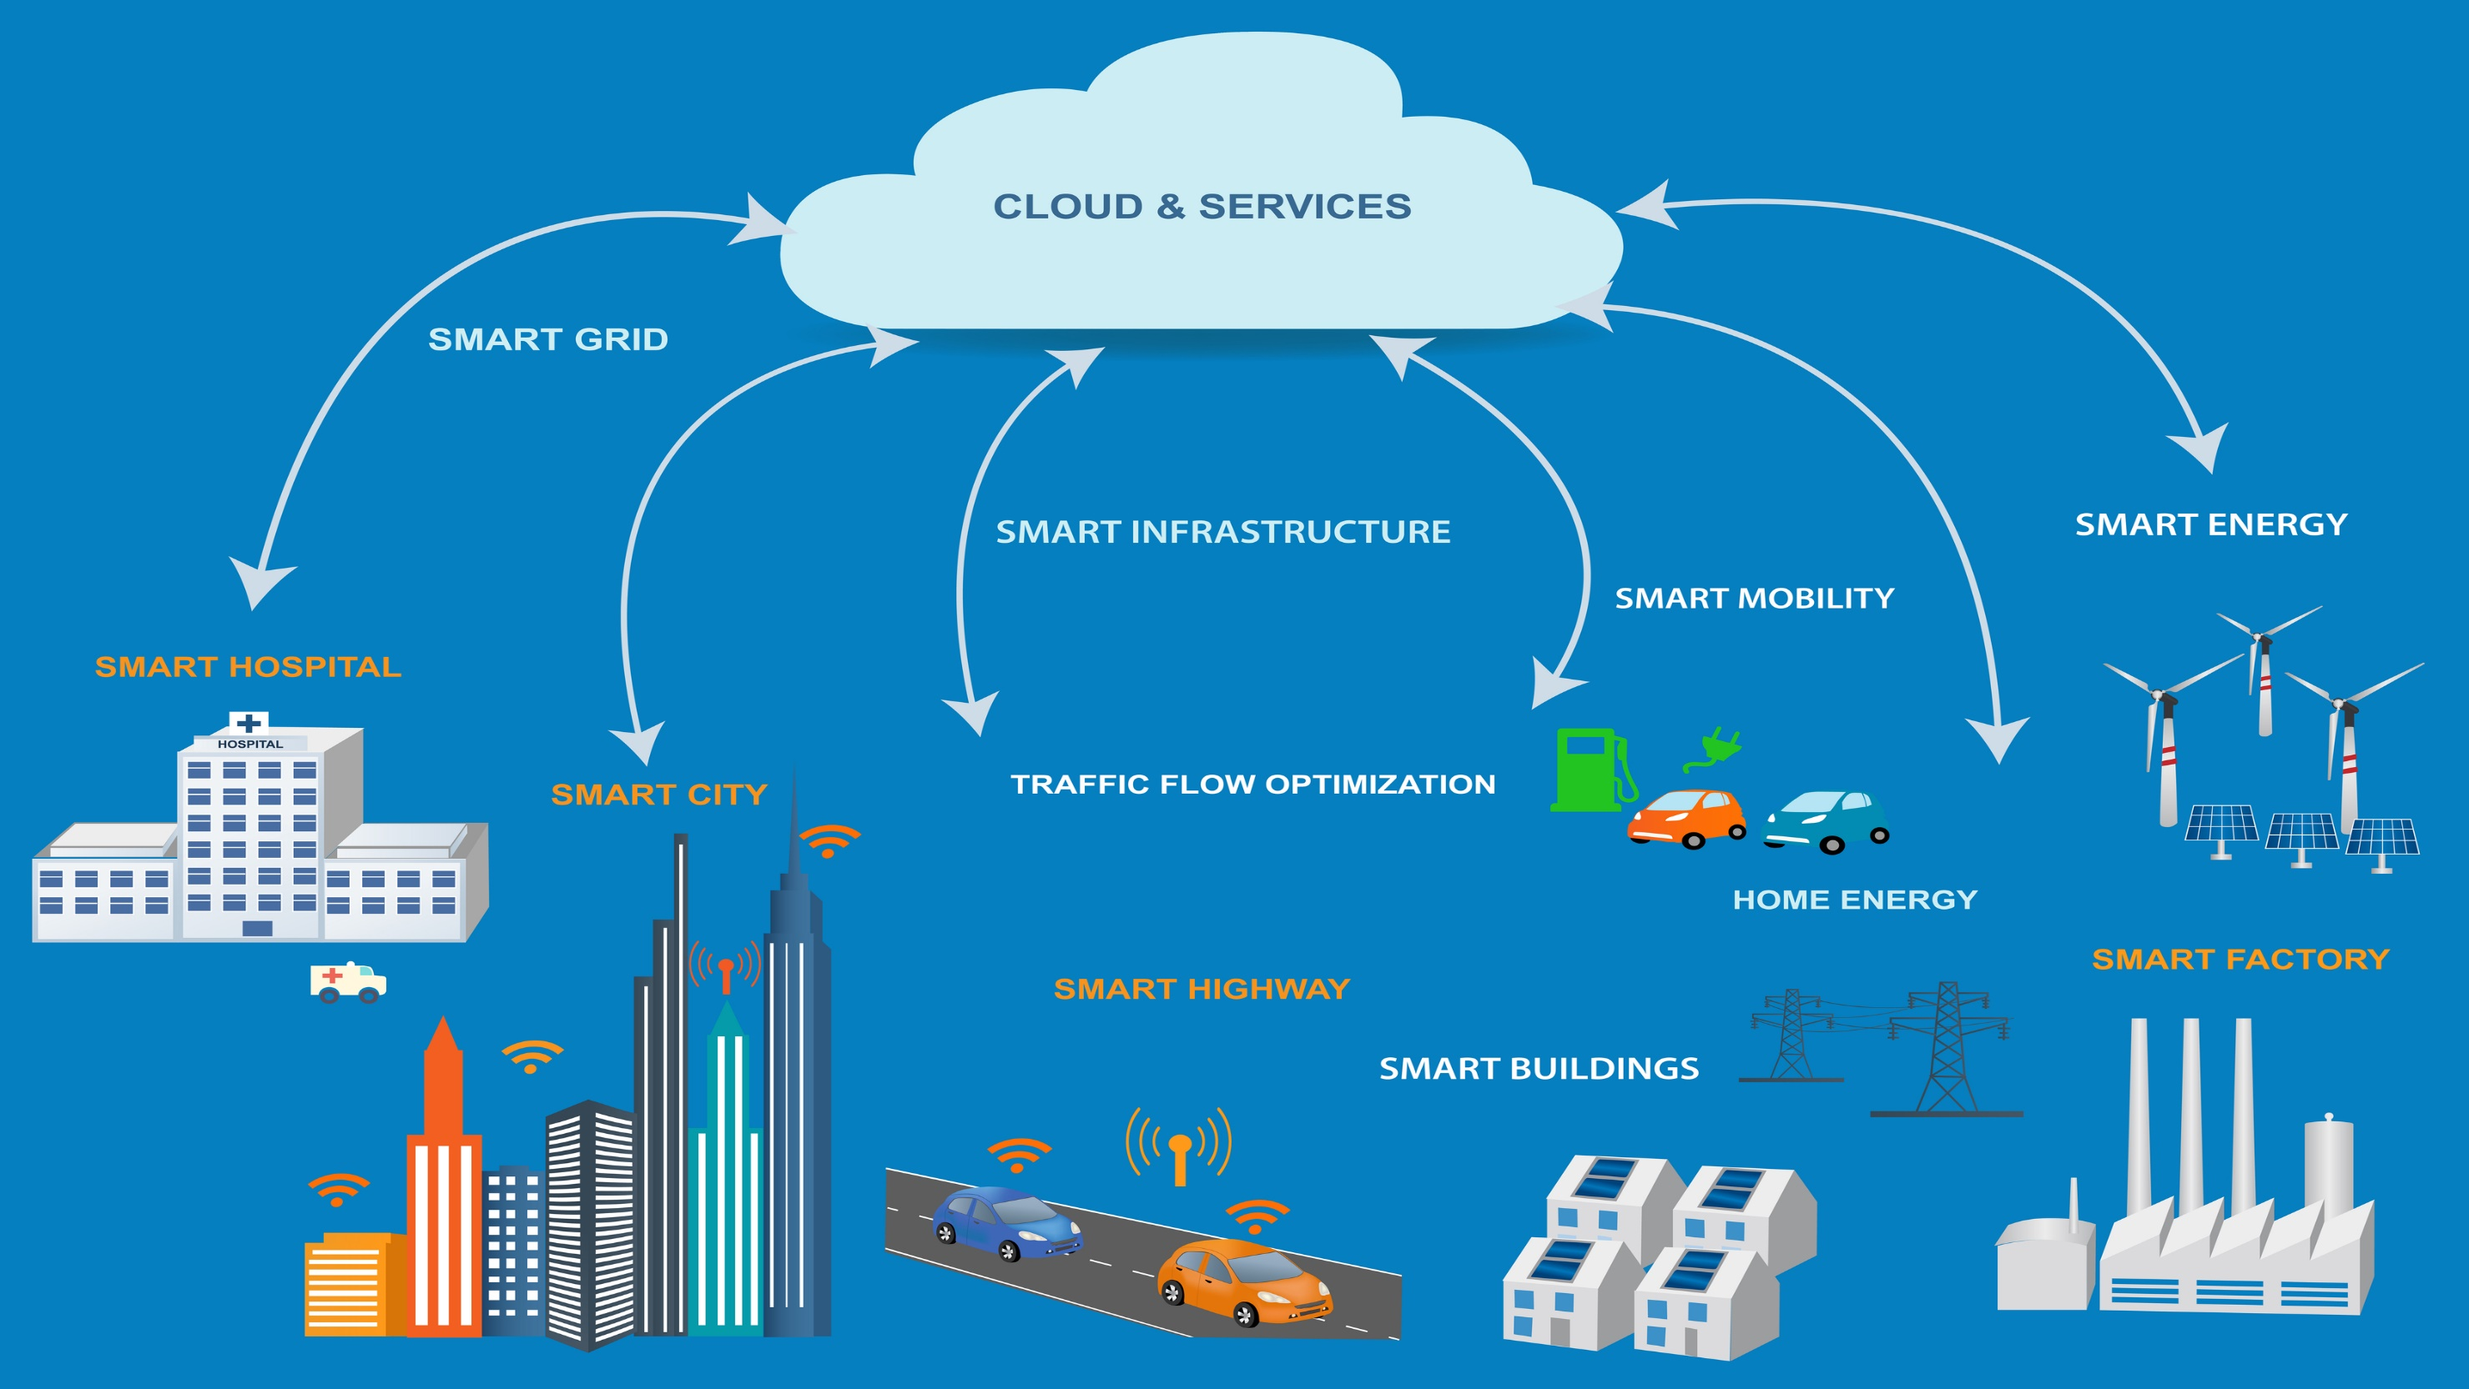
Notes:
One of the application can be environment or air-quality monitoring so that measures can be taken for any area affected by air pollution. For example, transportation system can be optimized based on vehicle monitoring and congestions can be controlled and infrastructure (road, subways, tramways)

Slide 5
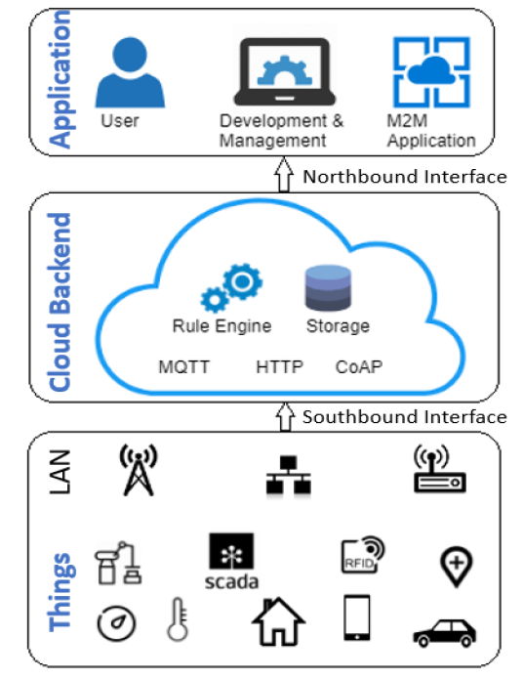
Internet of Things Architecture
Deployment of IoT system and its components can be composed of three major layers
  Hardware: sensing devices, communication hardware, actuators.
  Middleware: compute and storage resources for data handling
  Application: interpretation and visualization tools.
Figure 1 IoT architecture
Notes:
responsible to manage physical objects to sense the phenomenon in surrounding environment, These things need to be ‘connected’ so communication elements
the network layer is the infrastructure that is responsible for communication between these things . Wireless Sensor Networks (WSNs), Radio Frequency Identification (RFID) and IEEE protocols for instance Wi-fi (802.11), Bluetooth (802.15) and IETF Personal Area Networks (6LoWPAN) are some of the widely used technologies for connectivity
Processing and analytics are needed to be done from raw data acquired from sensors. Data with context or knowledge is produced through processing, machine learning algorithms or analytics for smart applications. This process is usually part of cloud layer of the architecture
the service layer enables the services utilized by user and applications. Finally, the interaction method by users and application is defined by the Interface Layer
Physical Layer: sensors, actuators, embedded communication hardware and Connectivity.
2. Middleware: storage and computing resources for data handling and prediction.
3. Application: User Application, Utility Management, data visualization and M2M communication.

Slide 6
Problem
Factors need to be consider are scalability, security and availability of the cloud ,That’s why it is proposed to deploy IoT components in a cloud-based computing platform which can provide functionalities discussed earlier
interoperability, security and standardization
Notes:
There are lots of challenges arising from middleware for instance, scalability, interoperability and security which are also suggested as one of the criteria for evaluation of platforms. Existing solutions addressed different technical solutions that may include pub/sub model, context-awareness and service oriented architectures [25]. Furthermore, there are commercial and open source middleware projects for real world application deployments available in the market recently.

Slide 7
Research Questions
1. What are the factors involved in Benchmarking for Performance Evaluation of an IoT Platform?
2. What is Performance of OpenIoT based on TPC-IoT benchmarking? (Scalability) as compared to another open IoT platform?
3. Suitable candidate for use case (air quality monitoring -IoT application)
Notes:
here are still some challenges to be addressed and questions to be answered in terms of standardization, cross-platform interfaces, security and communication protocols where lots of players are eveolving in the market

Slide 8
Motivation
aims to target the performance evaluation on the basis of two factors load scalability of a OpenIoT platform for air quality monitoring application
50b of devices connected by 2030 and as discussed above that it will populate the smart city and generate thousands of bits of data
cloud-based IoT platforms are needed to store, process and manage data
The capabilities of a typical IoT platform includes data storage, sensor or objects management, data handling and processing. It also ensures security, event processing, interface for administration, elements for application development, users and developers
Existing platforms of Internet of Things seriously vary in pricing formula, performance, limitation and functionality

Slide 9
Objective
The main objective of this research is to provide insight into key parameters in each layer of the platform affecting the overall performance
thesis, we proposed a IoT Platform Benchmarking Methodology comprised of four different evaluations namely; Technical, Usability, Sustainability and Market Competency.
The objective of Sustainability is to encourage the prioritization of sustainability goals by UN as part of the design of commercial projects in IT industry to maximize social impact, environment and economic effect while delivering, and potentially increasing, commercial value
target the performance evaluation on the basis of two factors load scalability of a OpenIoT platform for air quality monitoring application (where hundreds of sensors are updating data continuously). Performance is based on the matrix of latency, throughput and resource utilization of OpenIoT.

Slide 10
Research Premise

Slide 11
Hypothesis

Slide 12
Methodology
Related work: Detail literature review to identify parameters for evaluation of IoT platforms
Proposed benchmarking methodology: based on literature review to identify what other overlooked
Validation: evaluate performance of OpenIoT based on TPC-IoT benchmarking and compare

Slide 13
Background and literature review
IoT Platforms or Middleware: As a bridge to supports APIs, protocols and services
    OpenIoT
    KAA
Notes:
middleware is responsible for communication amongst heterogeneous devices, by providing a connectivity that is used by physical layer devices and by the application layers to provide services in the Internet of Things ].
Application Program Interfaces

Slide 14

OpenIoT Platform
Support large scale deployments based on cloud computing model
    Providing a platform for collecting and processing data from sensors
    After acquiring data its responsible for streaming data to cloud computing layer for storage and analytics
    Dynamically querying/discovering sensors and their data
    deliver IoT services that are converging from different resources
    Optimization of resources within the OpenIoT infrastructure and cloud computing module
Notes:
enables on demand utility or IoT servcie for example the sensing-as-a-service
Middleware, i.e. for sensors integration and wireless sensor networks

Slide 15

KAA Platform
KAA is also an open source middleware (cloud based)
provides device management through cloud connectivity which helps to acquire and provides data analytics
KAA platform offers a sandbox to install in VM for small scale uses cases, development, testing or experimentation

Slide 16
Benchmarking Methodology
key Parameters Indicators
      The Ingestion rate or arrival request per second
      Data Distribution (buffer distribution)
      Messaging Protocol (size, time, processing)
      Network Bandwidth (protocols overheads, processing and memory)
Notes:
vital role in terms of performance
1average arrival rate of the load of data per unit time
2over-all distribution of data over long period of time
3 MQTT, CoAP or NGSI have varying overheads bytes when it comes to memory allocation, messages processing time, or bandwidth distribution.
4 Network Bandwidth is depends upon overhead processing, message transmission period and I/O

Slide 17
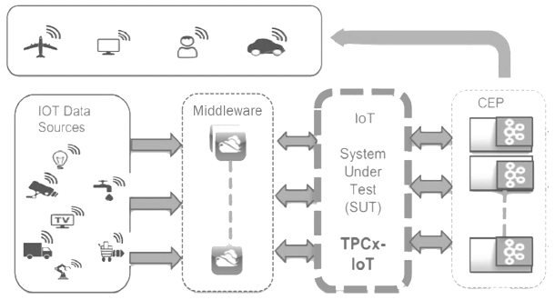
Benchmarking Methodology
TPC-IoT Benchmarking
Figure 3 TPC IoT Benchmark Architecture
Notes:
Typical IoT topology consists of three_tiers: edge devices, gateway systems and backend data center.
The Internet of Things gateways(middleware) are responsible for several purposes:
• Standardization of protocols for the connecting diffrent devices.
• Internet of Things gateways will be enable to filter, store, and verify data so that the end devices or sensors will be less stressed as they have limited capabilitites.
• It will help to build data analytics easier and make decision

Slide 18
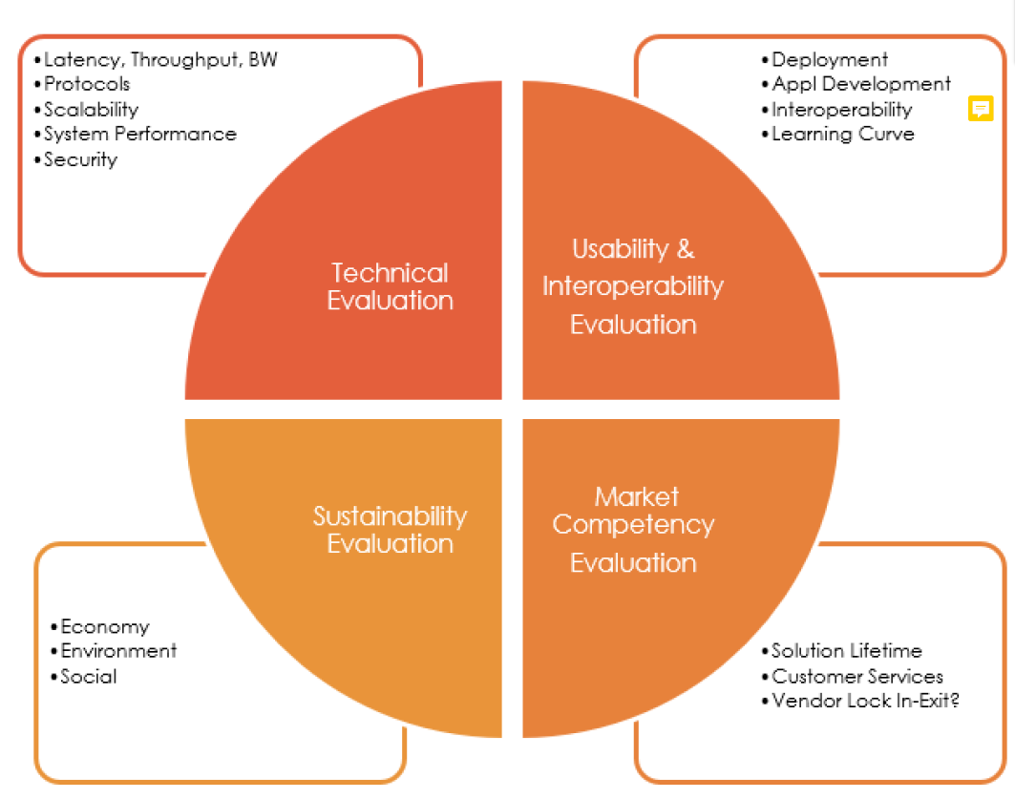
Parameters for Benchmarking
Figure 4 proposed Parameters for Benchmarking

Slide 19

Technical Evaluation
Network
Protocols
Scalability
Edge Computing
Backup/redundancy
Security
Notes:
1-network parameters for QoS, for instance latency, bandwidth, jitter, capacity packet loss etc can leave devastating effects on overall performance
2-most common application layer protocols used in IoT are MQTT, CoAP, AMQP, XMPP
3-is the ability of the system to accommodate the increasing load or elements gracefully without degradation of performance into the process
4-Edge:As edge devices or gateways are becoming more powerful, it is possible to take autonomous decision .It can increase the application performance due to less delay and less load on back-end cloud
Scalability (Network, load, and virtualization)
• Density of Devices
• Mobility Support
• Real-Time Response
5-Backup: does this cloud-backend provide data backup plan? How often it takes place
6- It is one of the significant challenge in IoT due to the lack of standards and architecture as it is still growing

Slide 20

Usability & Interoperability
Interoperability: being connected to anything, anytime, and anywhere will rise the heterogeneity among the IoT systems and platform
Deployment of Platform: how easy to deploy platform and it services. user friendly!
Notes:
قابلیت همکاری
: being connected to anything, anytime, and anywhere will rise the heterogeneity among the IoT systems and platform making it hard to be interoperable the devices, software or services amongst other IoT platform

Slide 21

Market Competency
One should keep in mind while availing the services:
Solution Lifetime
Community/Customer Service
Vendor Lock In/Exit
Notes:
Just imagine an industrial manufacturer consuming IoT services using an IoT platform, and with the pace of technological advancements it is likely to raise question about the life time of the solution as older systems are becoming discrete new versions of sw are available so one need long-time support. It is very important to achieve a vendor/technology solution which is easily transferable or upgradable in case such need arises. Avoiding vendor lock-in is one of prime importance while creating a future-proof architecture for IoT platform 42

Slide 22
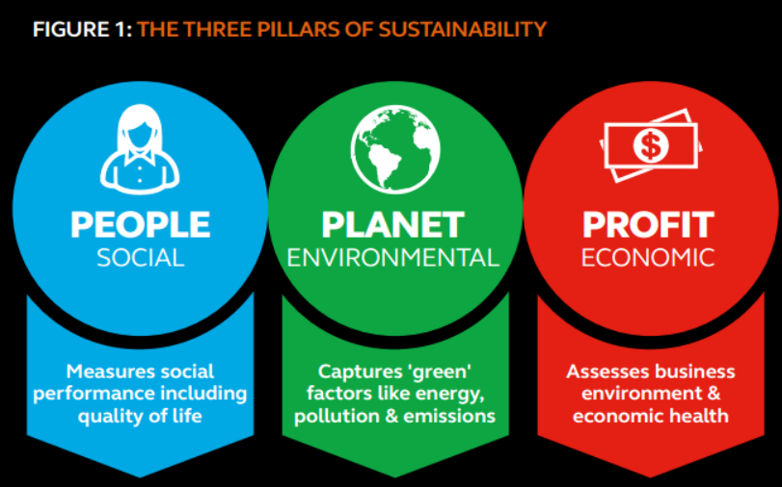
Sustainability Pillars
Notes:
This thesis focus on Technical, Economic and Environmtal dimensions with Immediate Effects. Performance Benchmarking of IoT platform will enable stackholders to chose the right platform for available applciation hence its improve the resource utilisation and also enables stakeholders to balance the environmental effects i.e. carbon footprint of the solutions. In enabling effect, it will directly targets the social, individual and economic dimensions
The concept of Internet of Things will also target the sustainability aspects. It has good 14
potential to target many sectors to increase the efficiency of systems into the economy by optimizing the processes of business models and industries. Research shows that it can eradicate 15% of carbon emissions gobaly using the smart technologies by 2020 [20].This chapter will cover the fundamental architectural elements of Internet iof Things. Later, we elaborate the middleware and frameworks in the concept of Internet of Things. Lastly, Two of the open source IoT platforms, OpenIoT and KAA and their functionality will be discussed. Their architecture, specifications and componencts to build applications

Slide 23
Results
Table 1Message Delivery Intervals of KAA Platform
Figure 7 Avg. Time for Delivery Time Intervals

Slide 24
Results
Table 2 Data Ingestion and Standard Deviation
Figure 8 Avg. Time for Delivery Time Intervals

Slide 25
Comments
He designed experiments for technical evaluation parameter between four of them
Used a LAN as it is not able to measure cloud performance
Writing and organization issue
Figures don’t have label or correct figure numbers
He claim a lot but delivers little
Confusing subsections
Sections in the wrong place not coherences -not native
Simulation was used not a real environment
Notes:
(“due to time limitation only one of the evaluation process is being tested

Slide 26
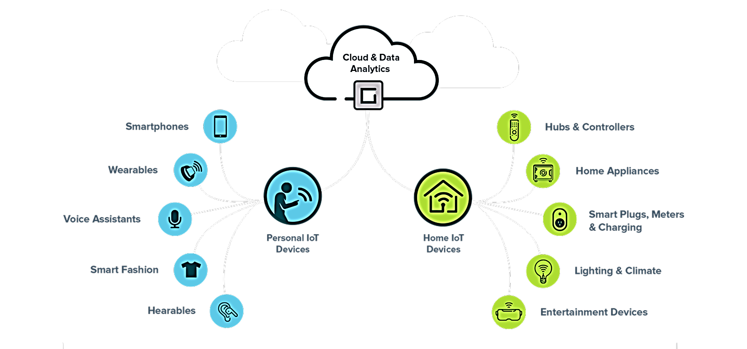

Slide 27
Conclusion
Notes:
Sensing layer is responsible for gathering data from sensors and APIs or other networks and actuators are also deployed in this layer. Actuators and sensor are usually energy and computing constraints. Suitable storage and compute platform is required for the processing and storage of data gathered from the sensing layer. Device management also plays an important role. Factors need to be consider are scalability, security and availability of the cloud

Slide 28
IoT Application Protocols
Constrained Application Protocol (CoAP)
Message Queue Telemetry Transport (MQTT)
Advanced Message Queuing Protocol (AMQP)
Notes:
is an open layer protocol for the IoT which mainly focuses on the message-oriented environments. AMQP

Slide 30
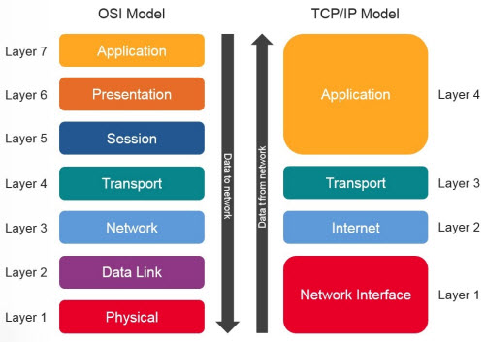
Internet layers
Figure 2 IoT architecture

